Slide 1
Learning from Data
At this point, you should have already seen Learning to See Parts 6 and 7.
Let’s briefly review part 7 to make sure it makes sense – really understanding part 7 is critical for what comes next.

Slide 2
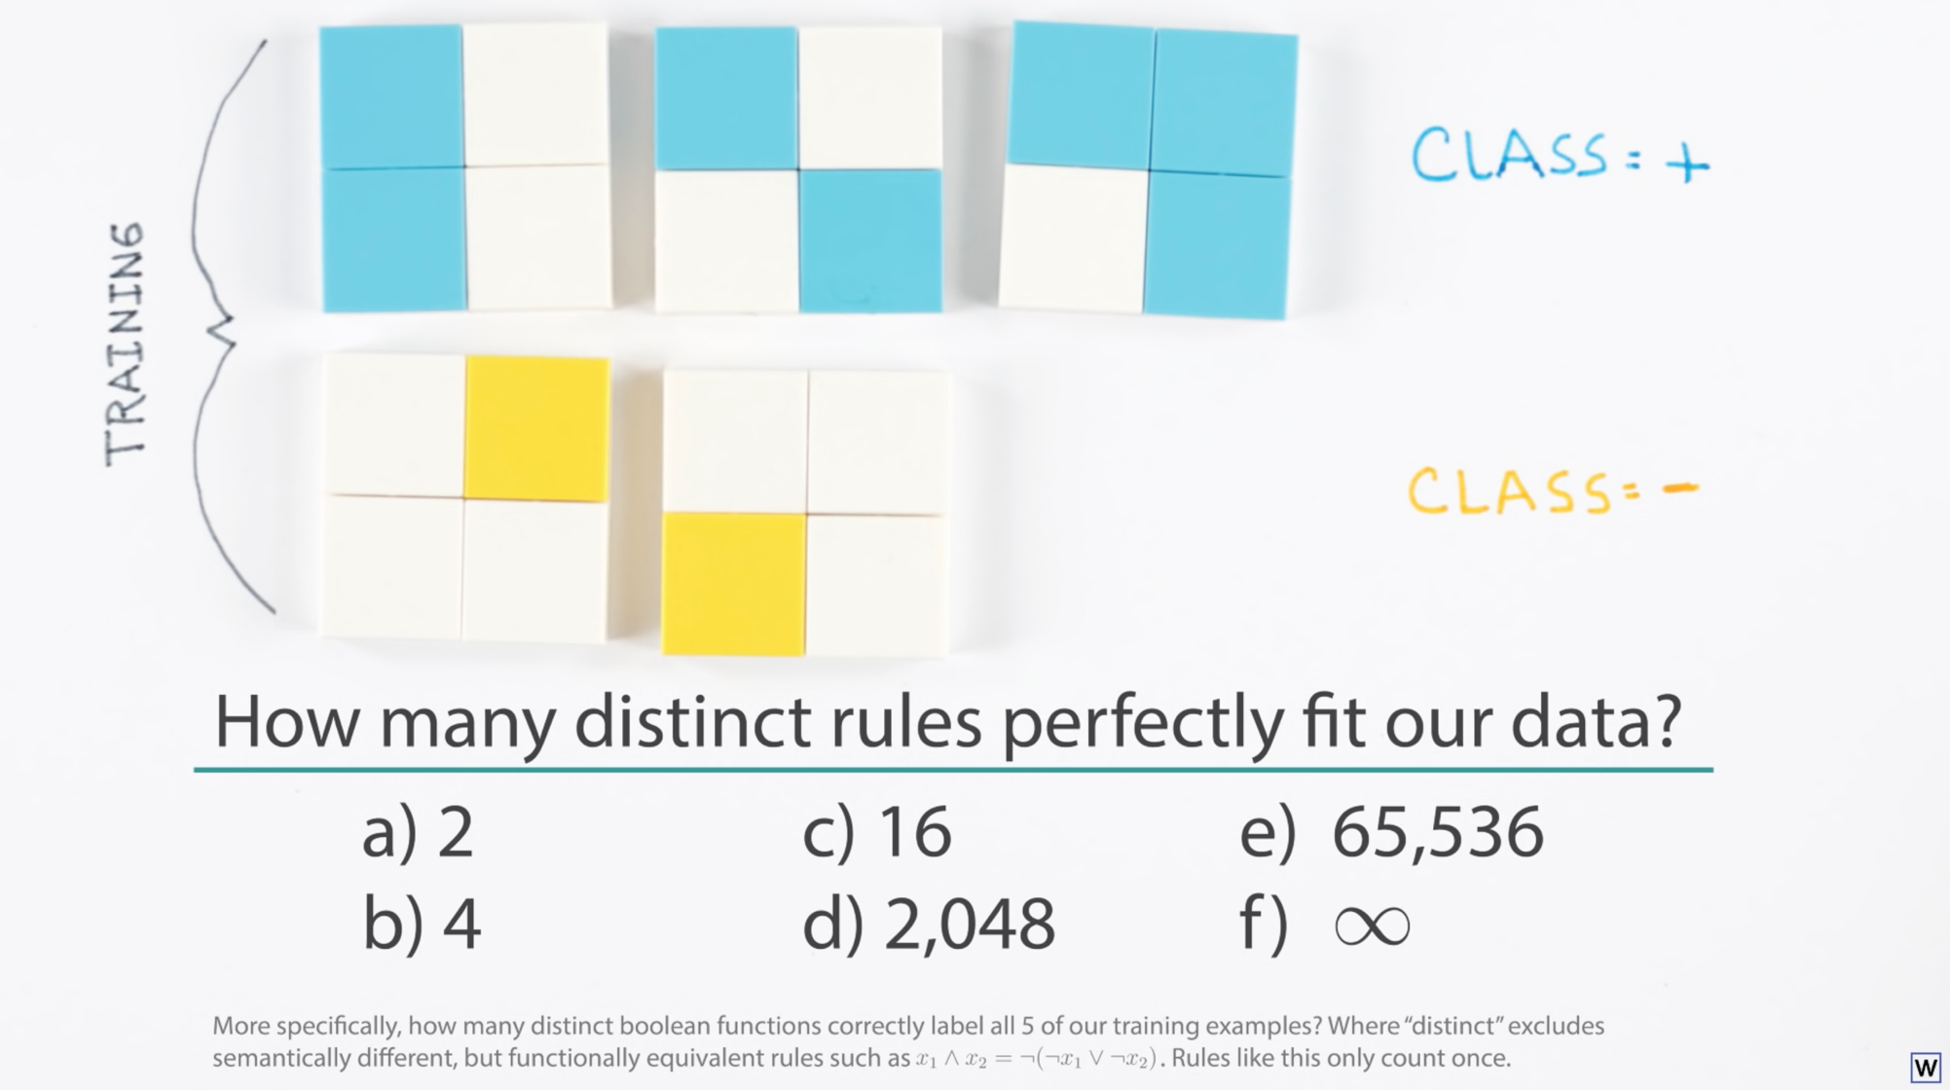

Slide 3
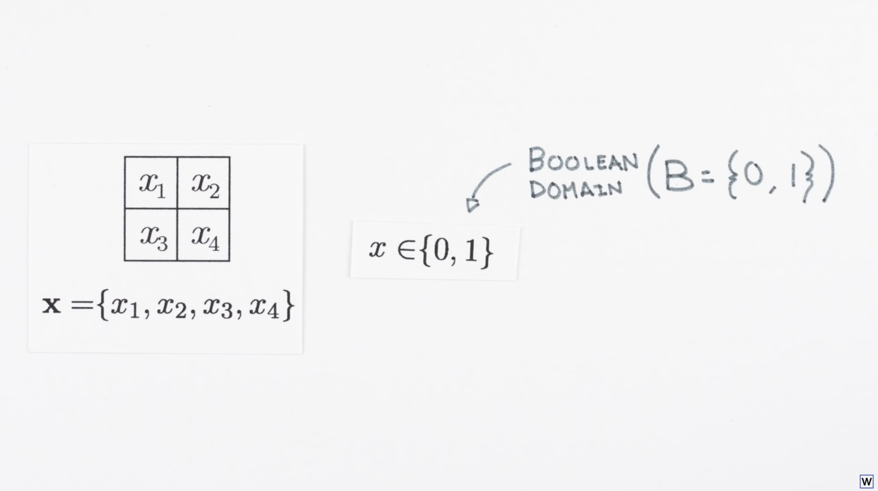

Slide 4
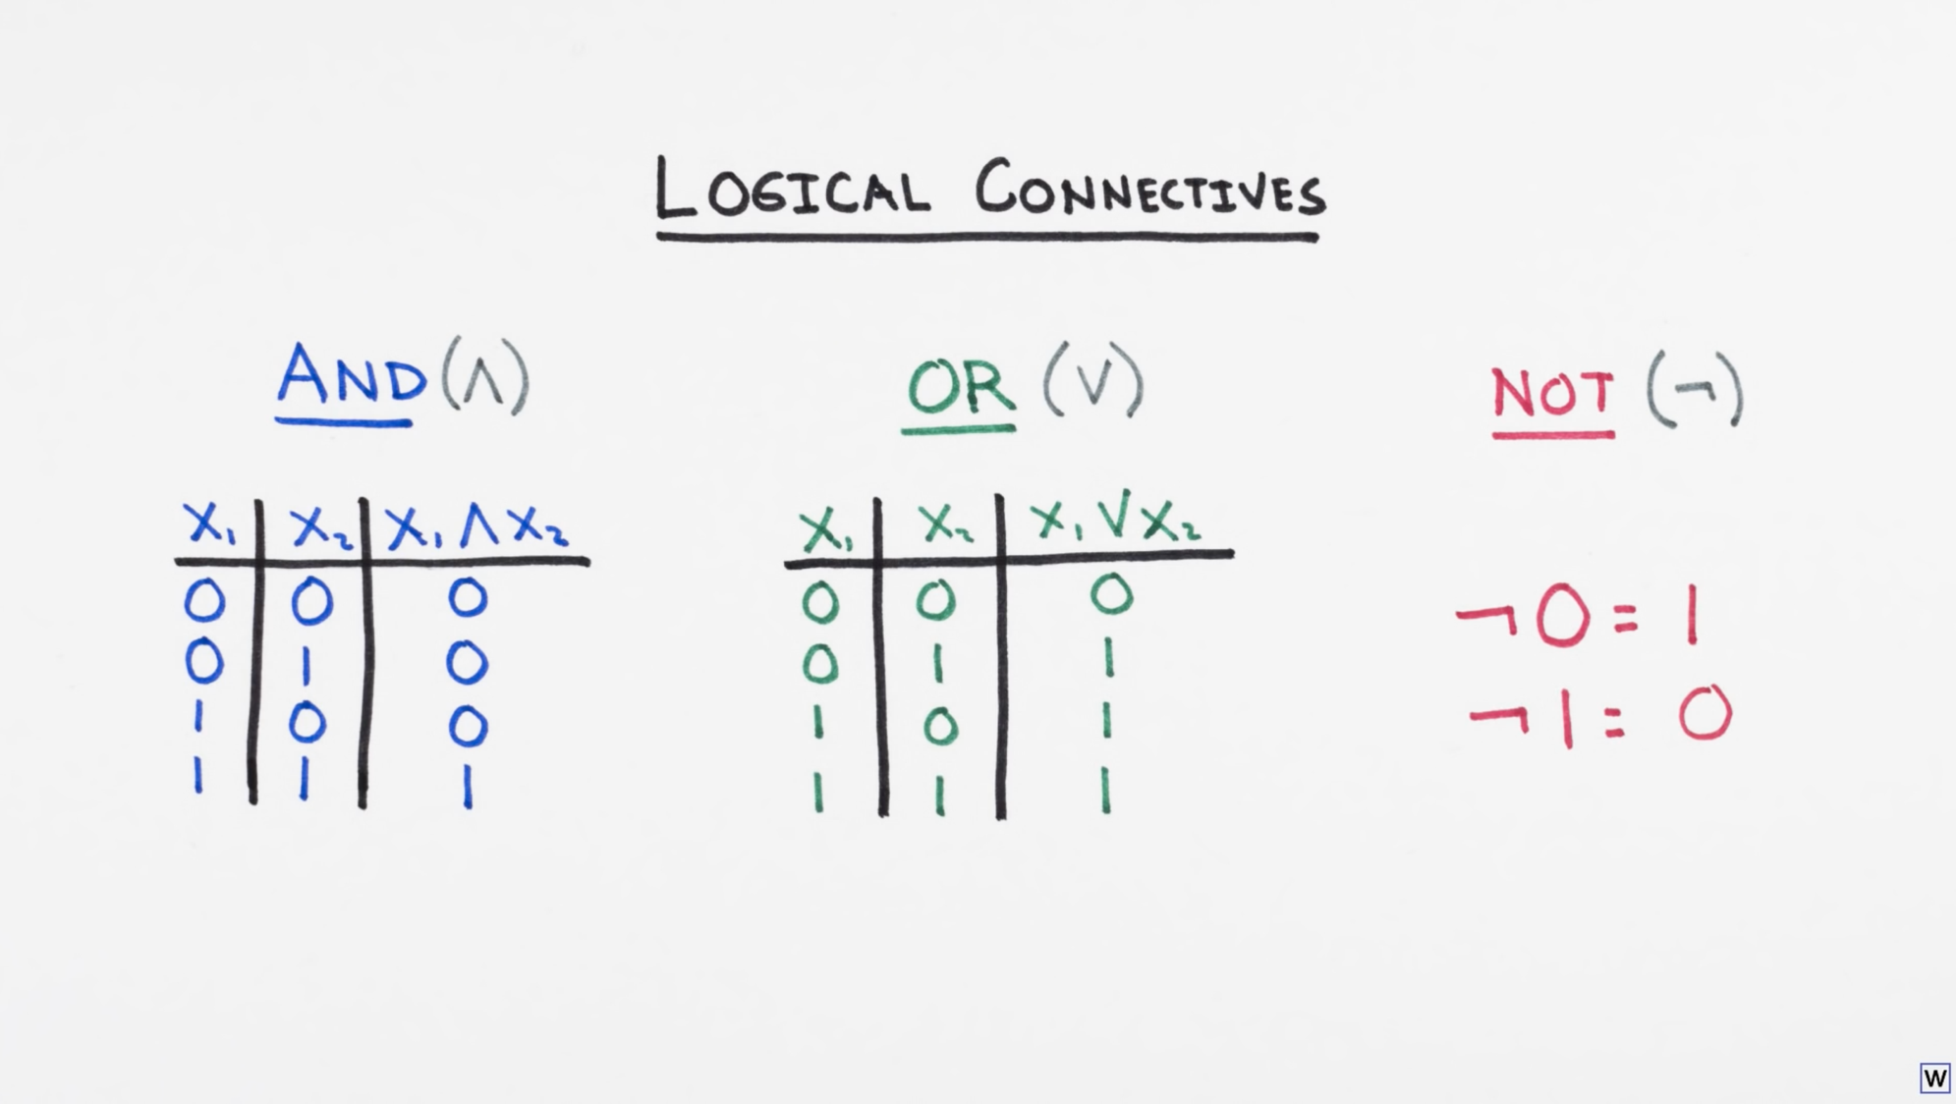

Slide 5
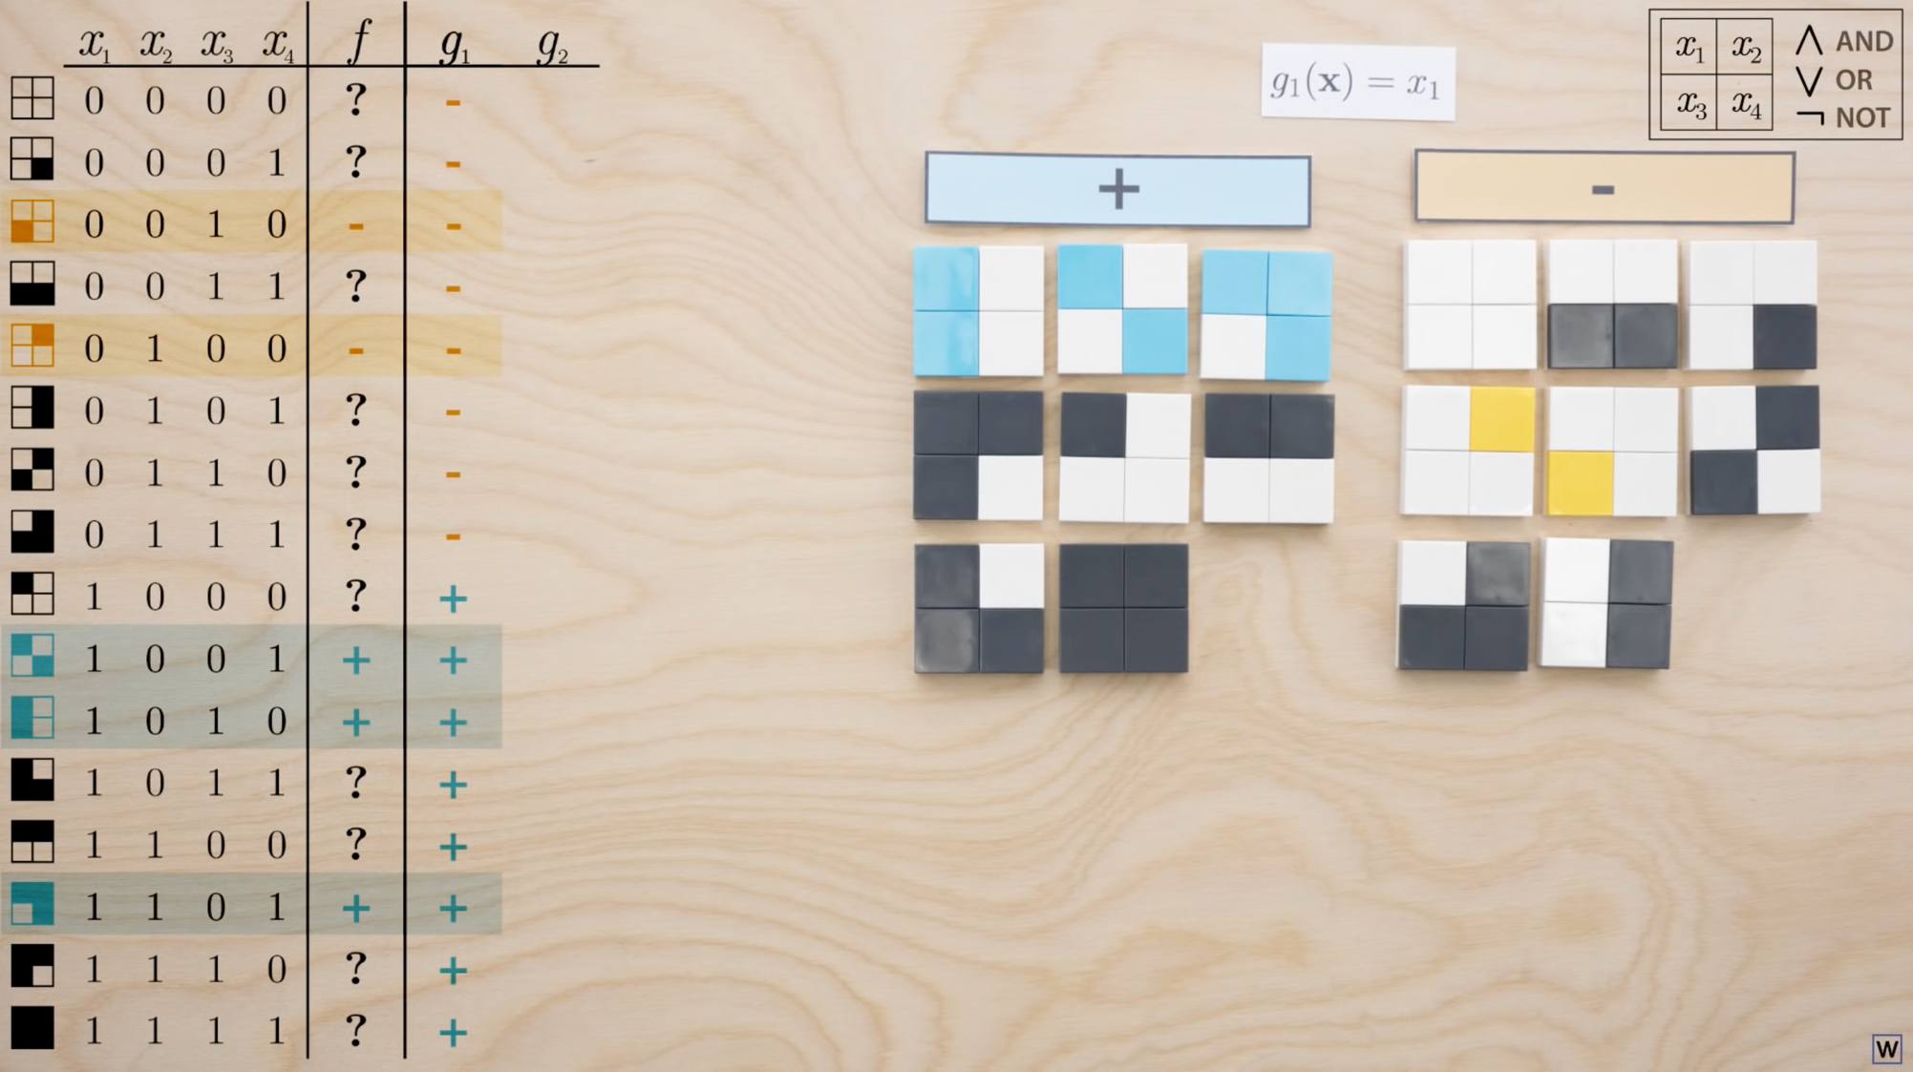

Slide 6
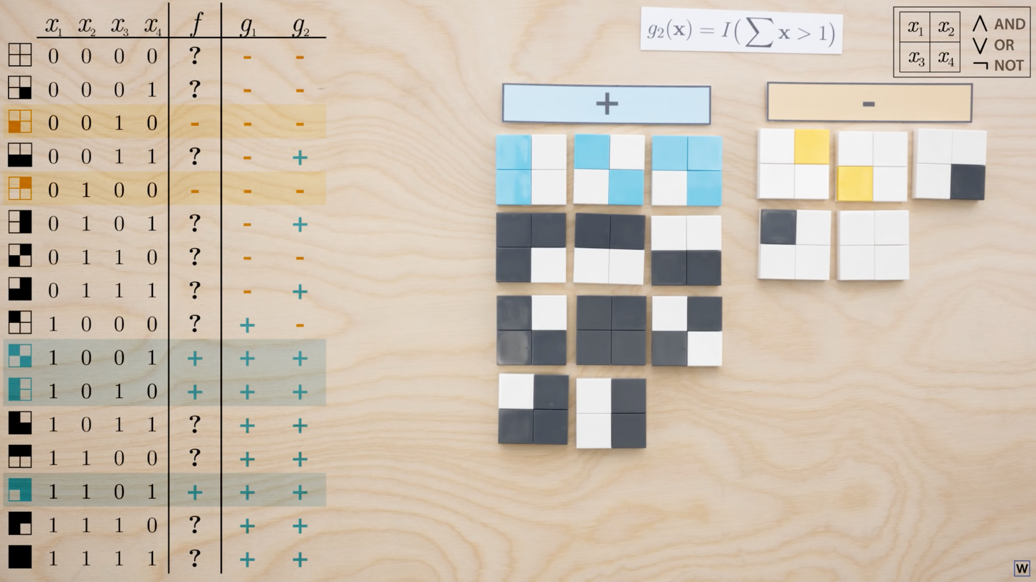

Slide 7
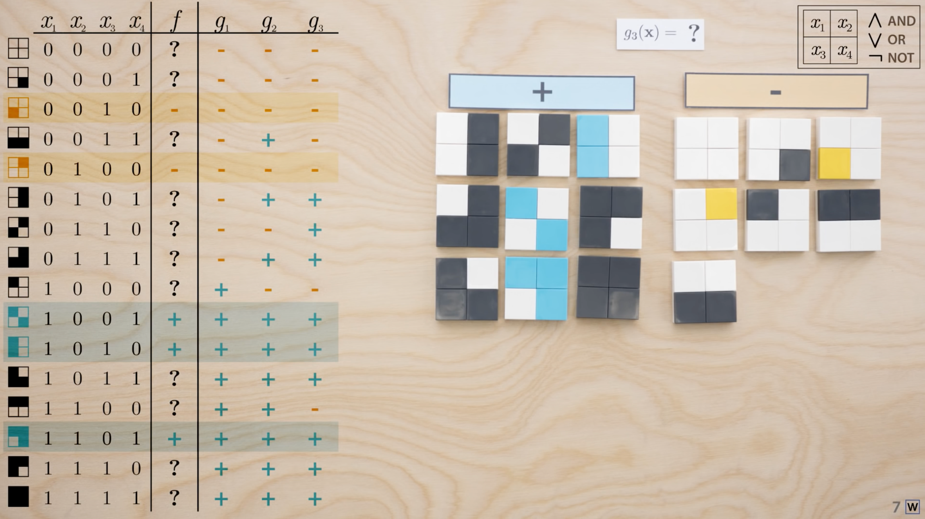

Slide 8
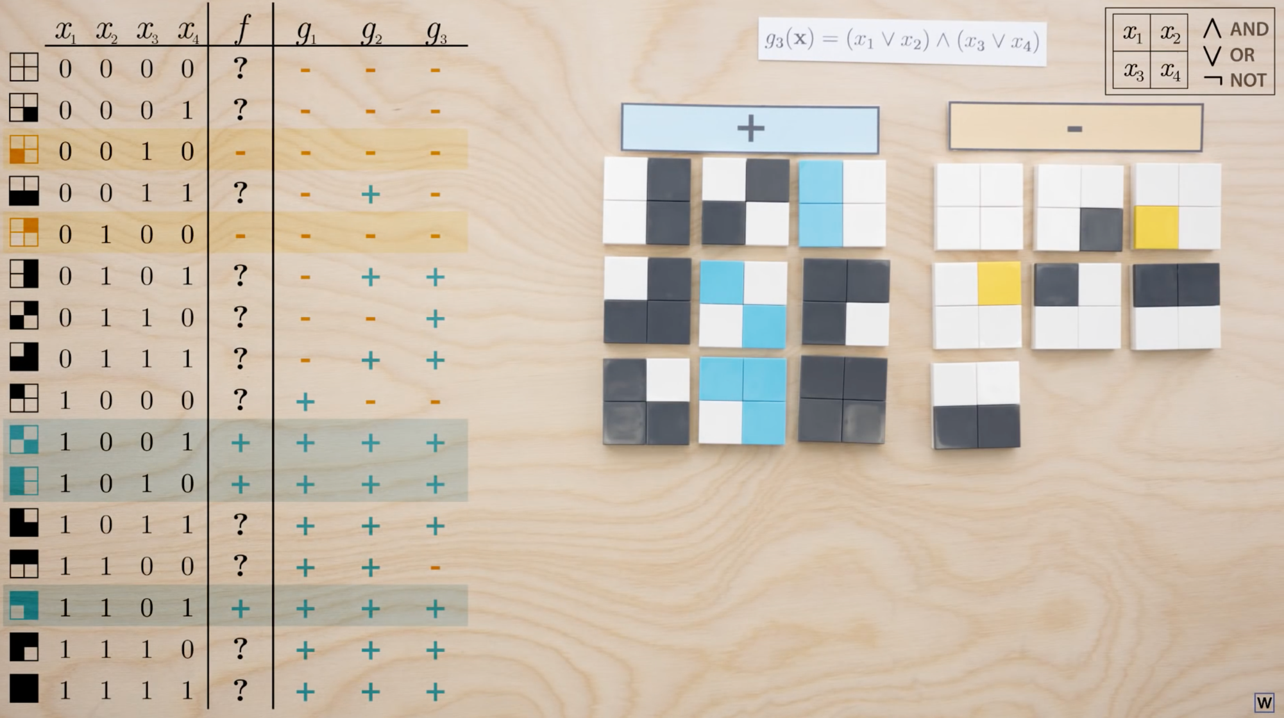

Slide 9
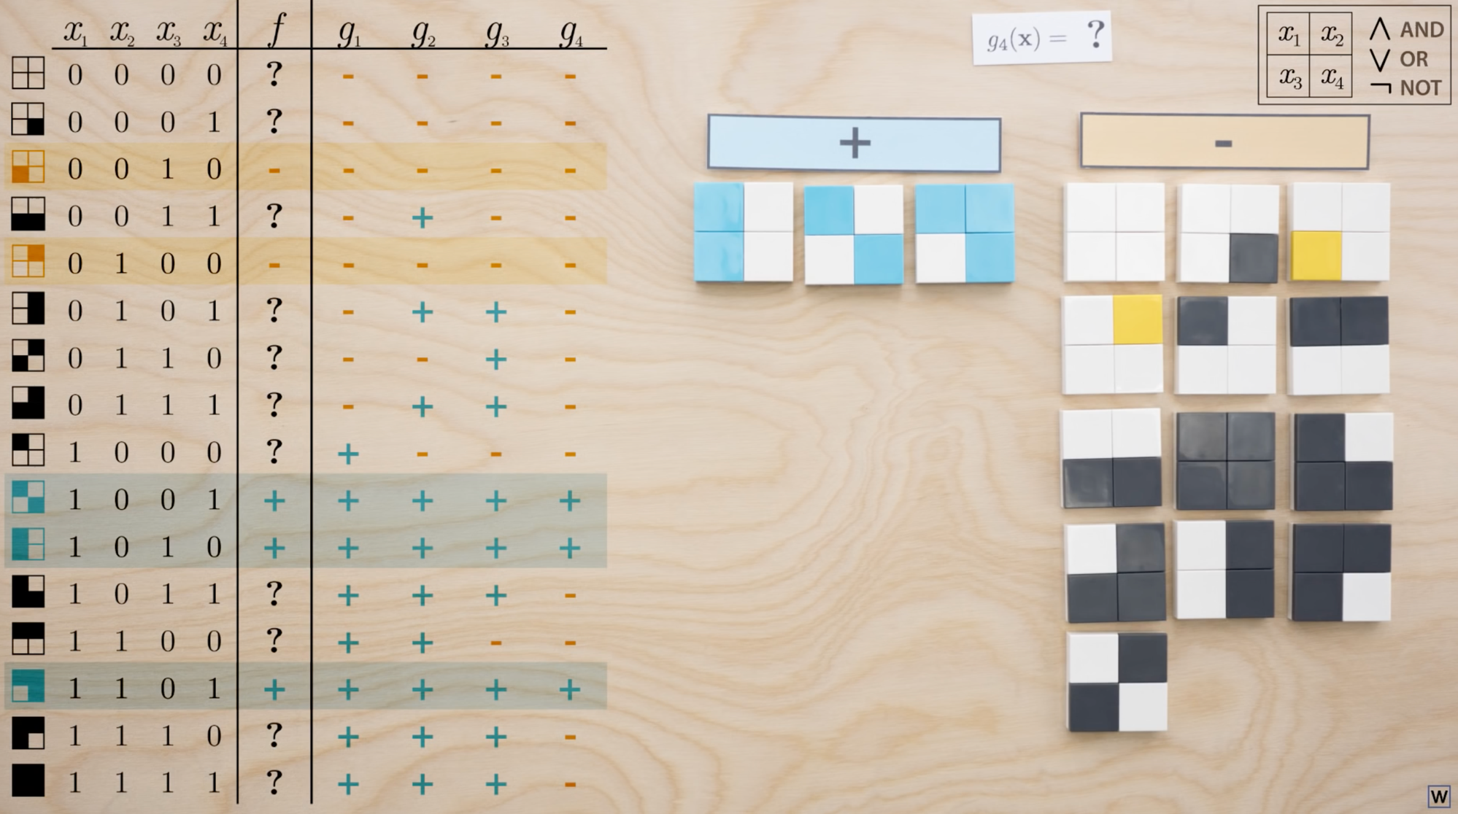

Slide 10
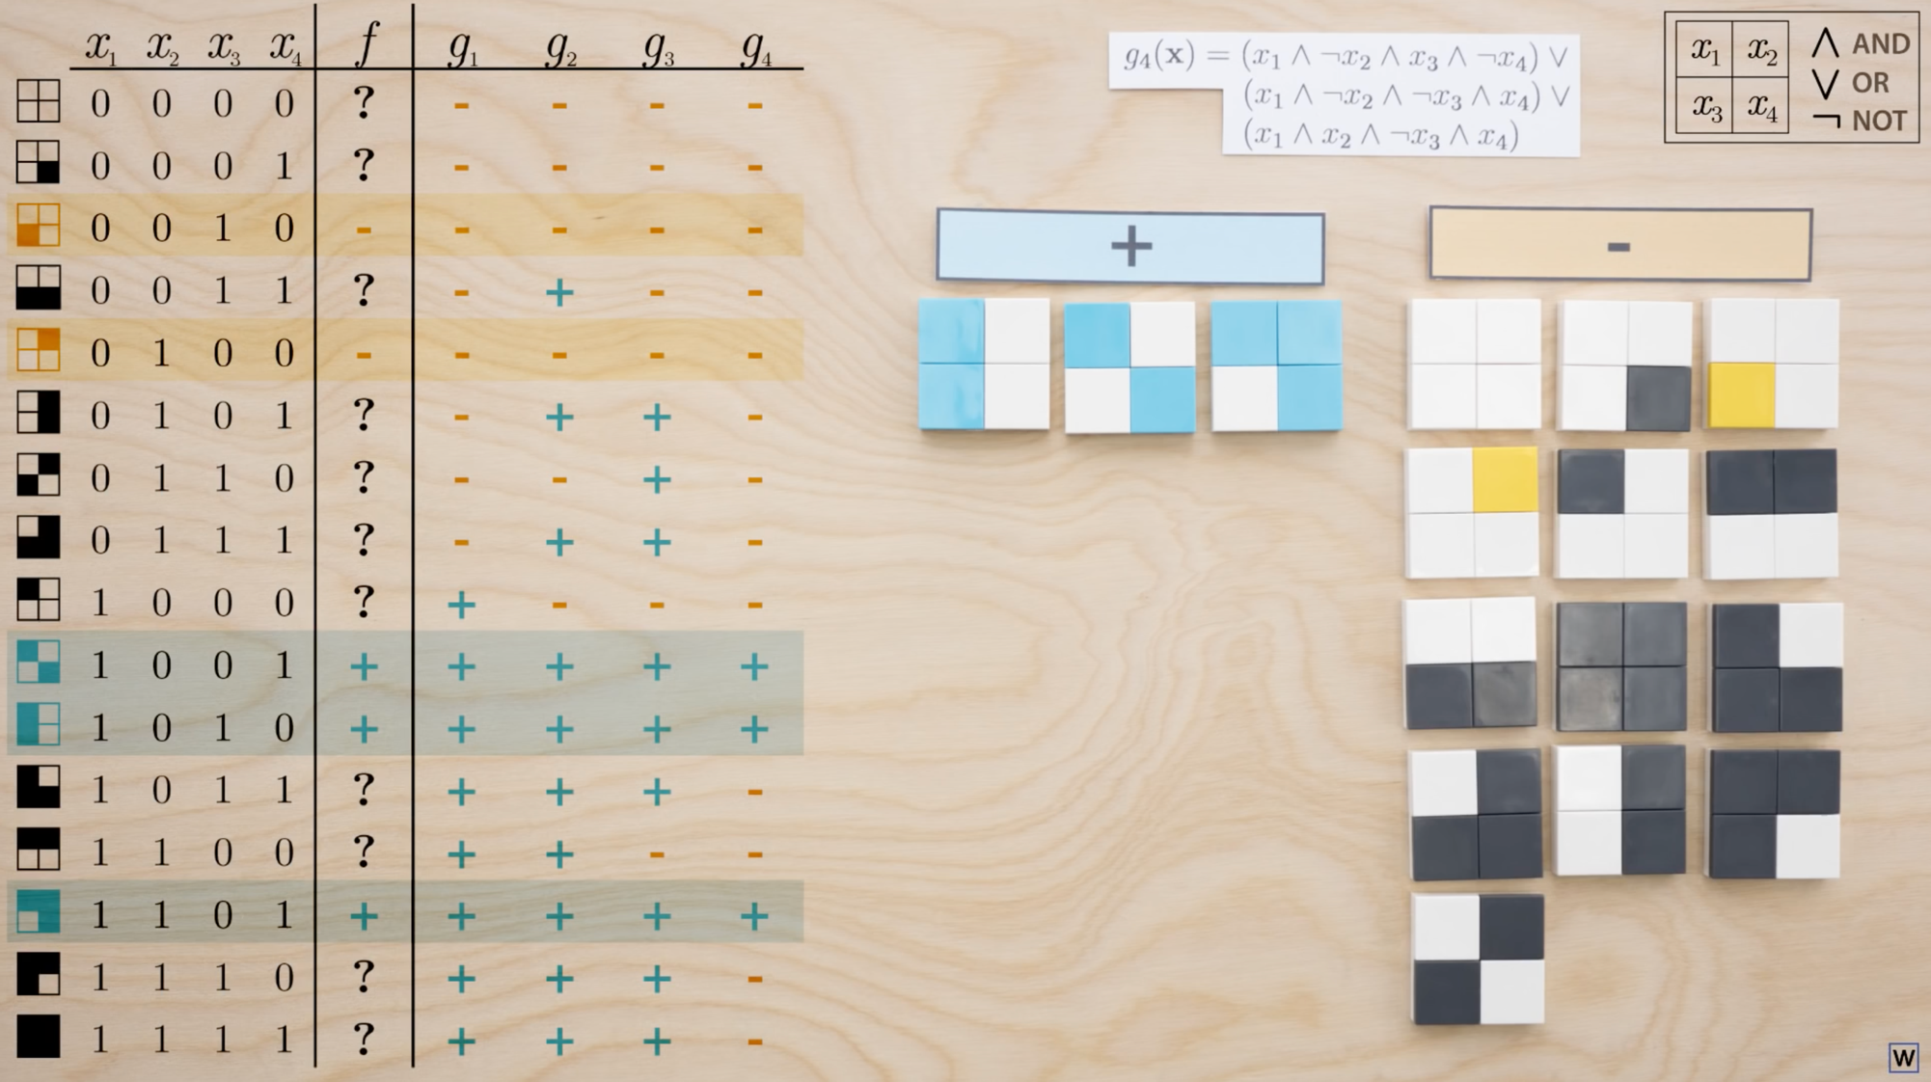

Slide 11
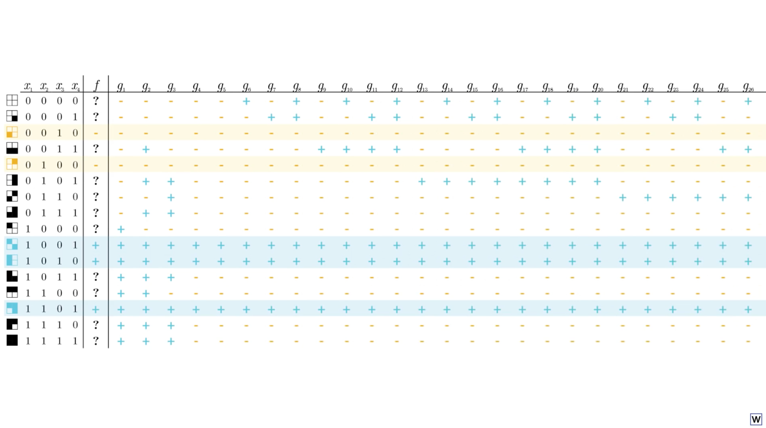
…
Using logical connectives, we can make a rules to match any possible combination of truth table values!

Slide 12
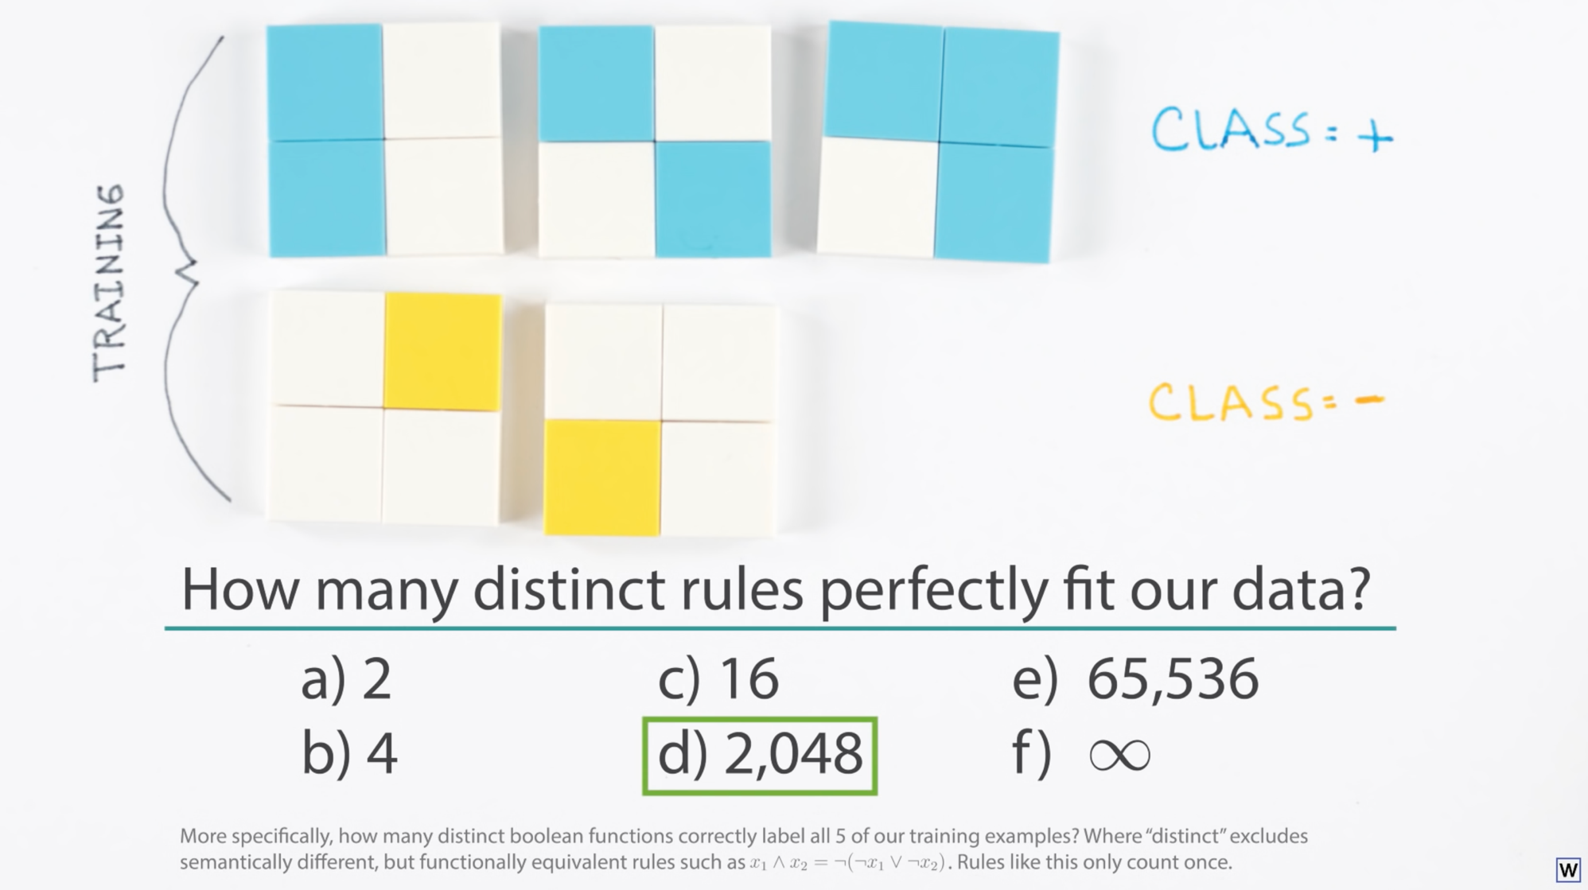

Slide 13
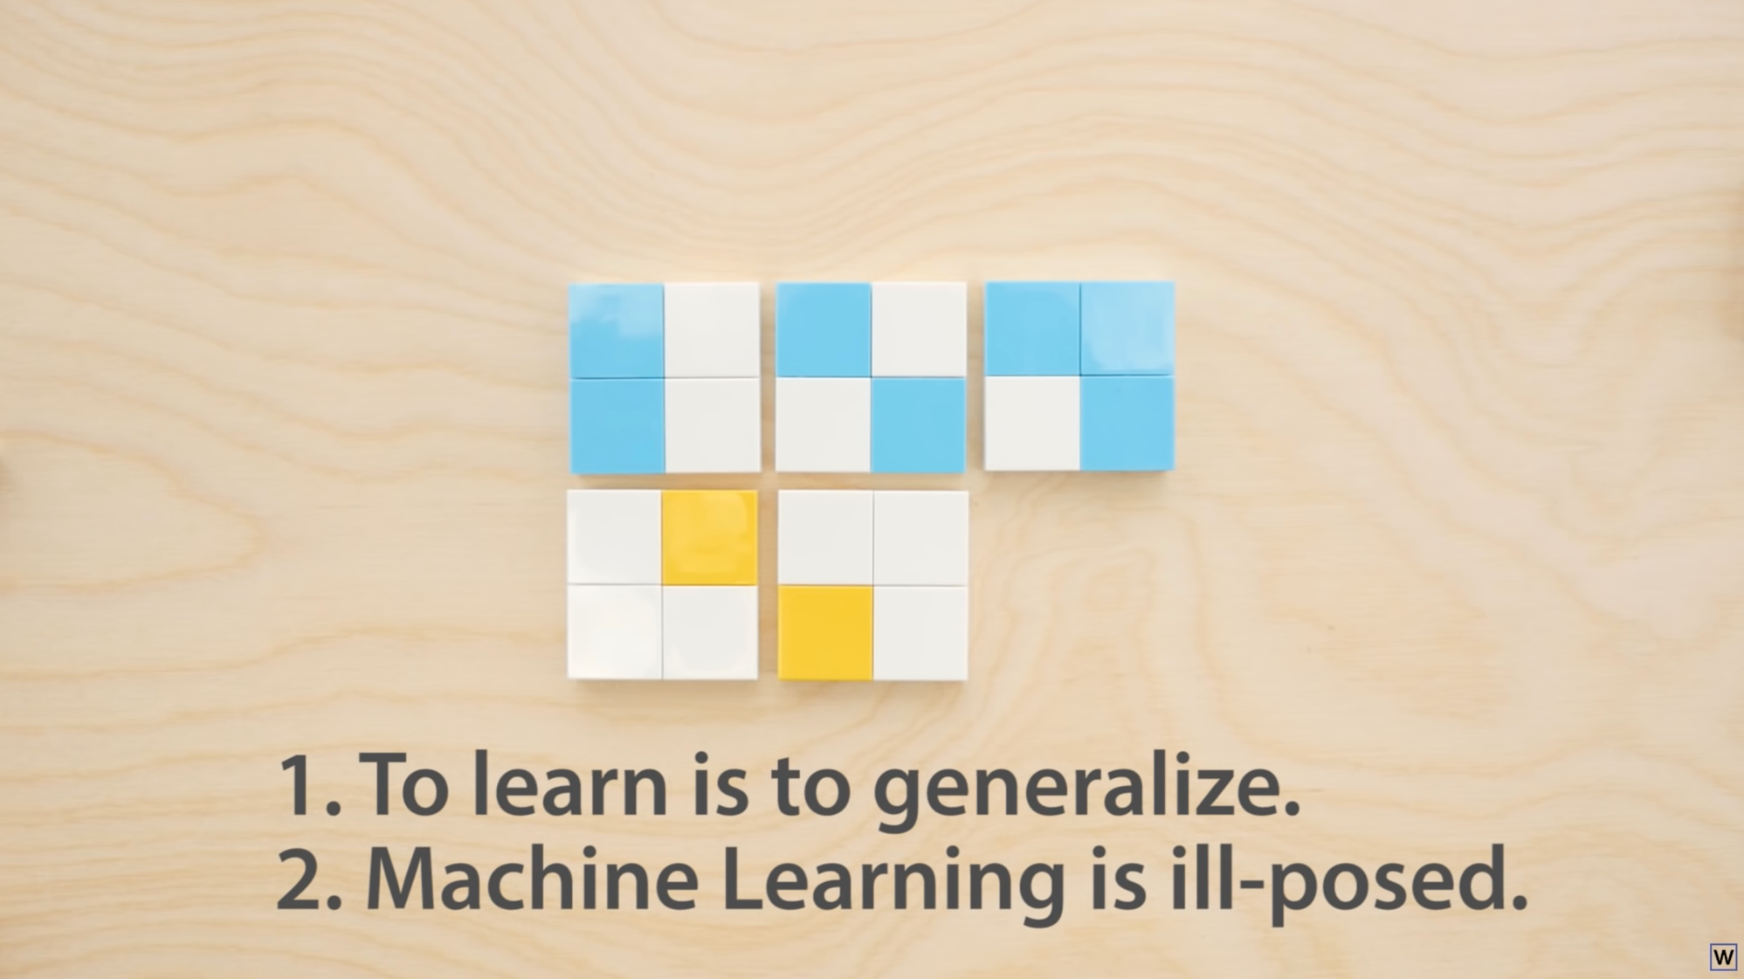

Slide 14
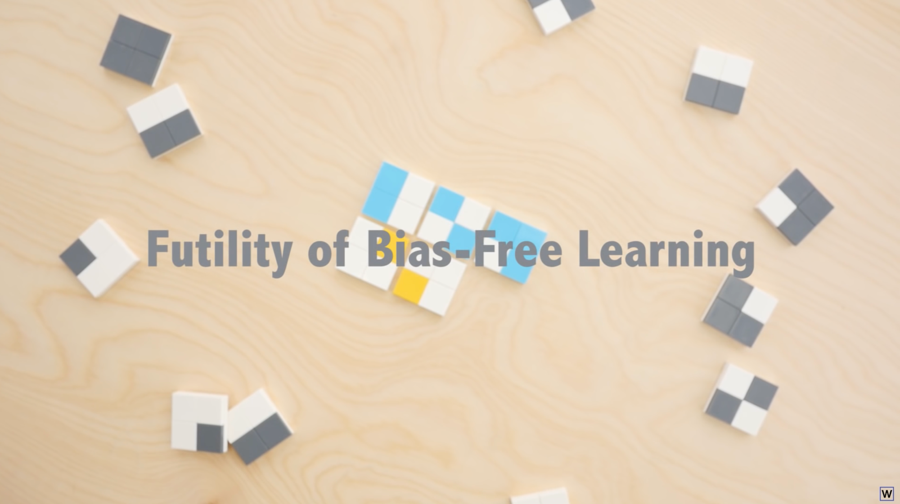

Slide 15
So, it seems like Machine Learning is pretty successful…how does it work then?

Slide 16
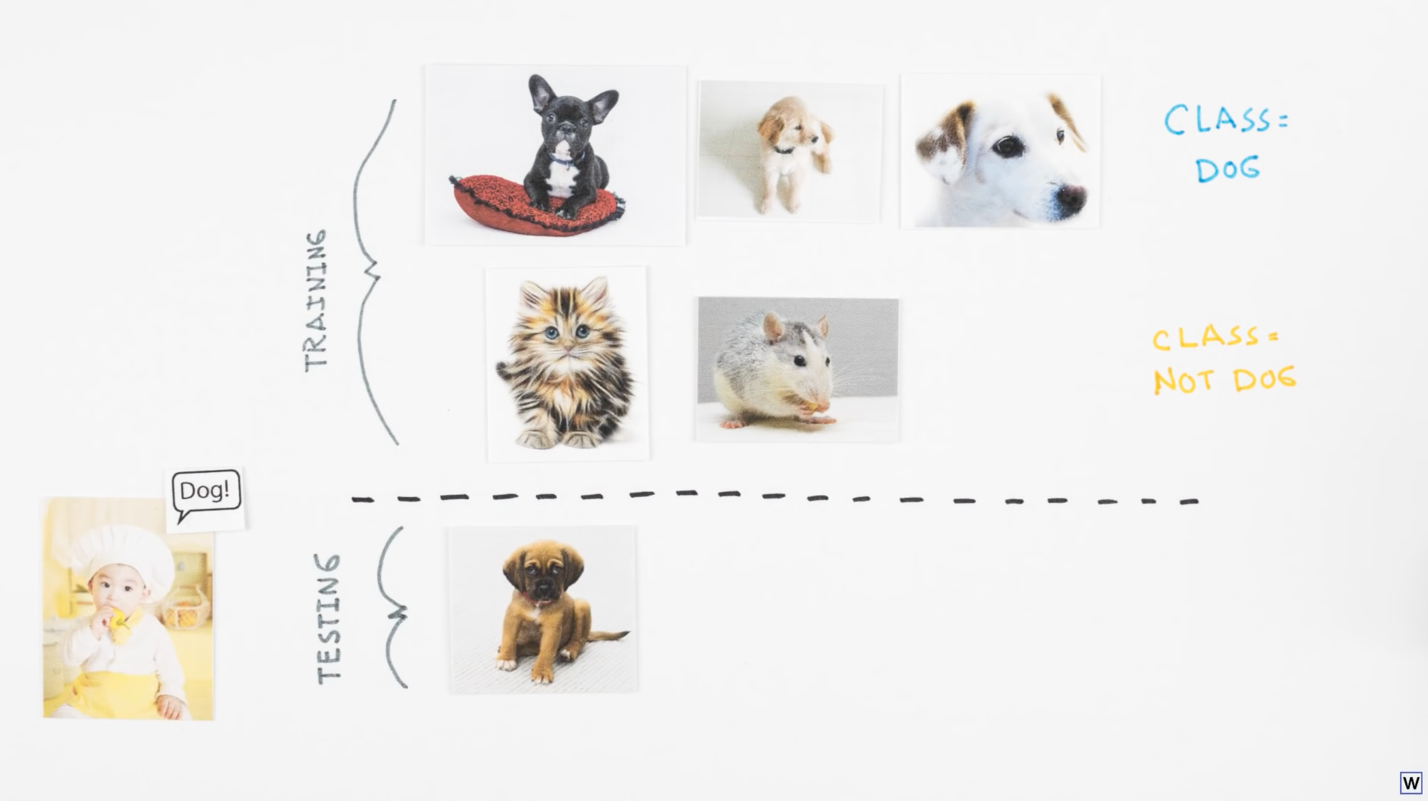
Notes:
Let’s think about how human’s learn for a moment. Even children are really really really good at generalizing.

Slide 17
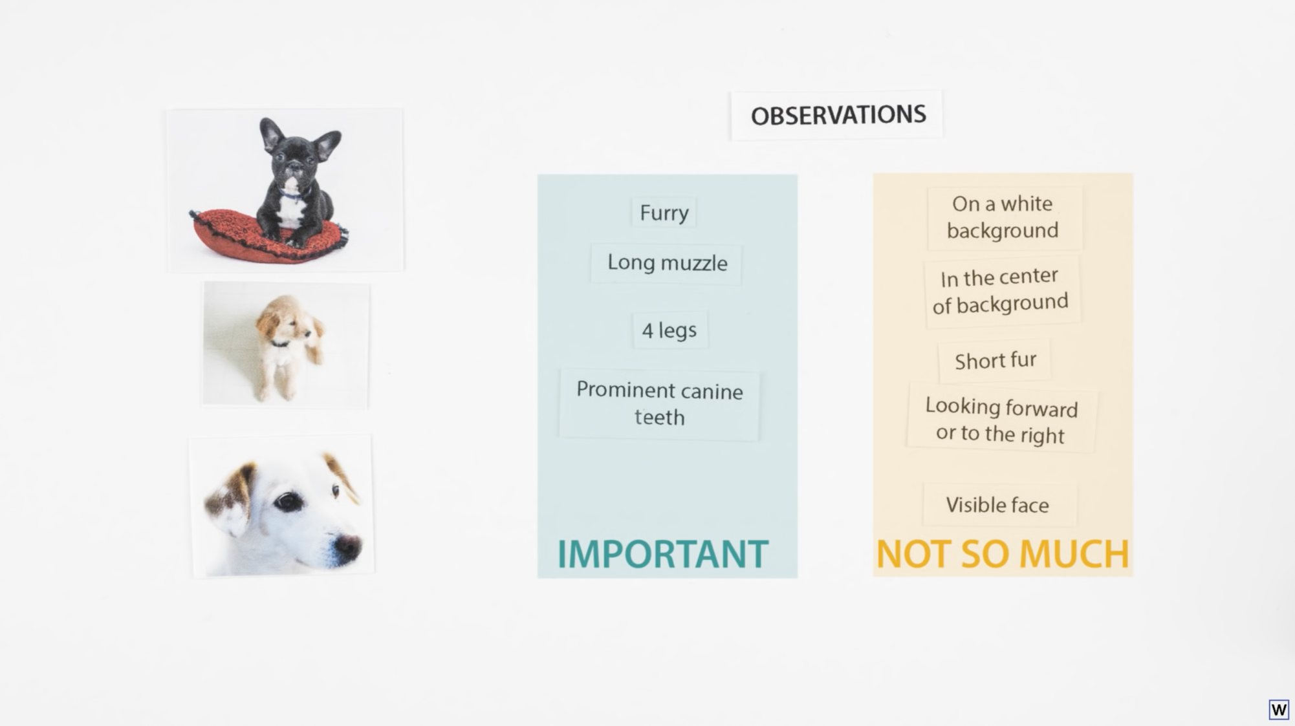
Notes:
One important part of human learning might be the ability to pay attention to what’s important and what’s not.

Slide 18
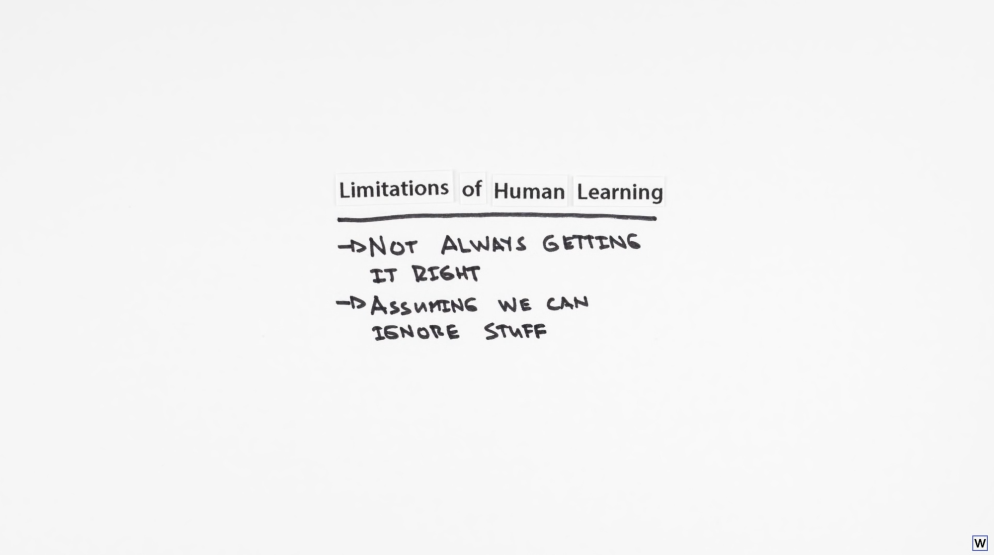
Notes:
What if these aren’t limitations at all, but an important part of actually learning? This is of course, a loose metaphor, we machine learning doesn’t work because it’s directly modeled of human learning. However, we could gain some insight here, foe example, maybe trying simple rules where we selectively ignore information could be valuable.

Slide 19
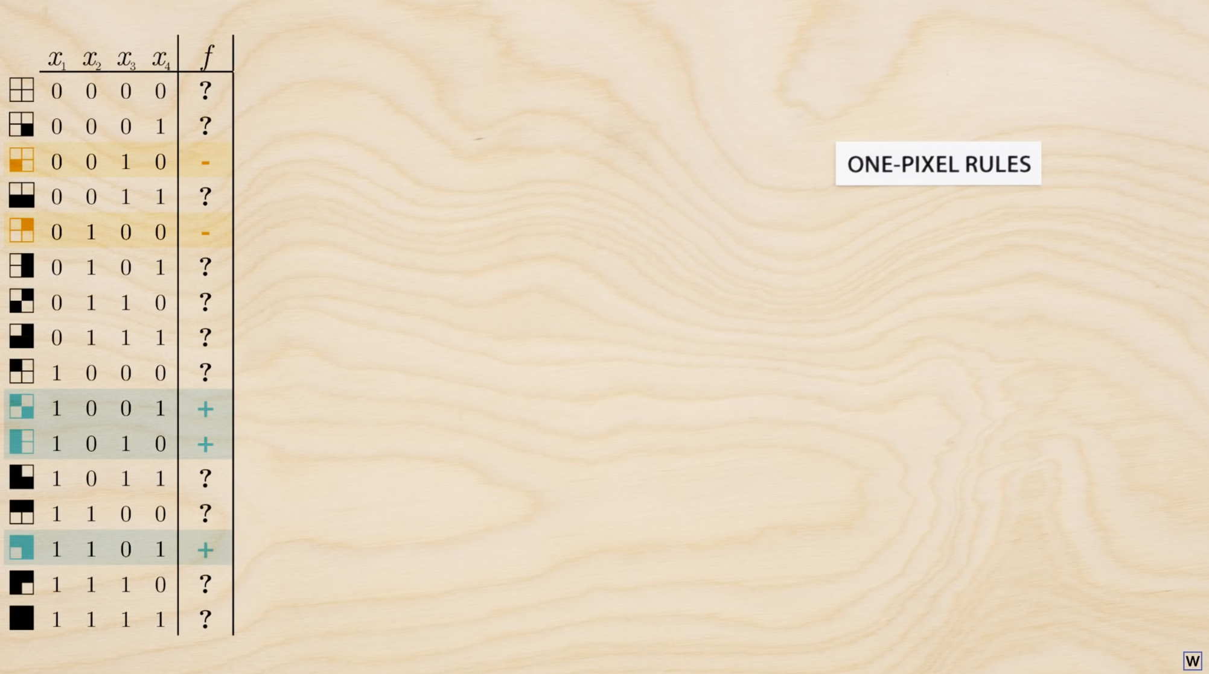
How many unique rules exists that use only one of our 4 x-values?
4
8
c) 16
d) 32
Notes:
Let’s spend a little time thinking about simpler rules, where we don’t use all the available information.

Slide 20
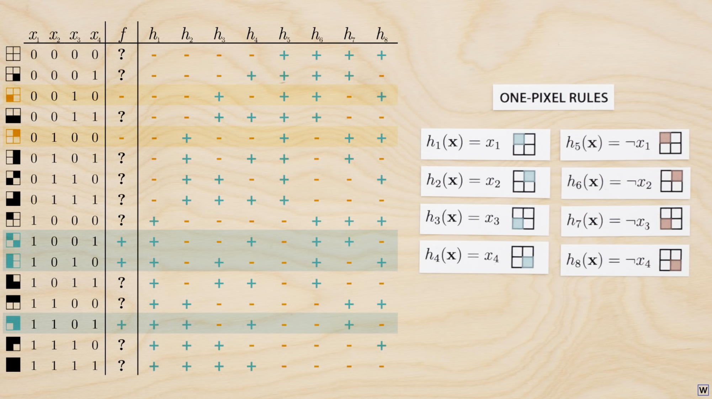

Slide 21
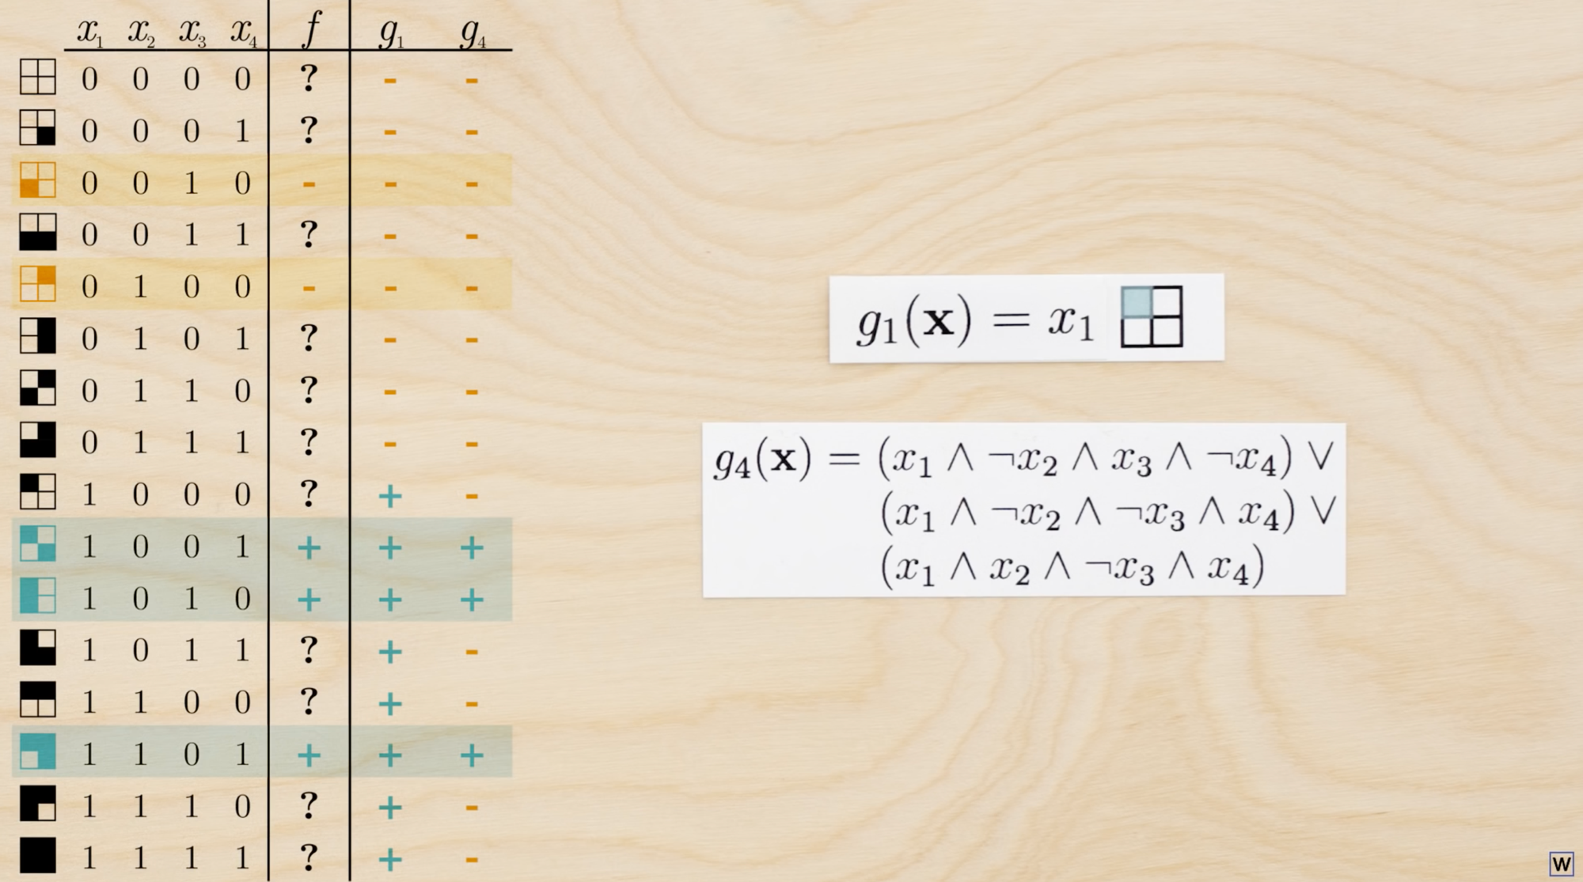
We learned last time that learning is really about generalizing. Do we have any reason to believe that a rule like g1 would generalize better than a rule like g4?
Notes:
Do we have any reason to believe that a rule like g1 would generalize better than a rule like g4?

Slide 22
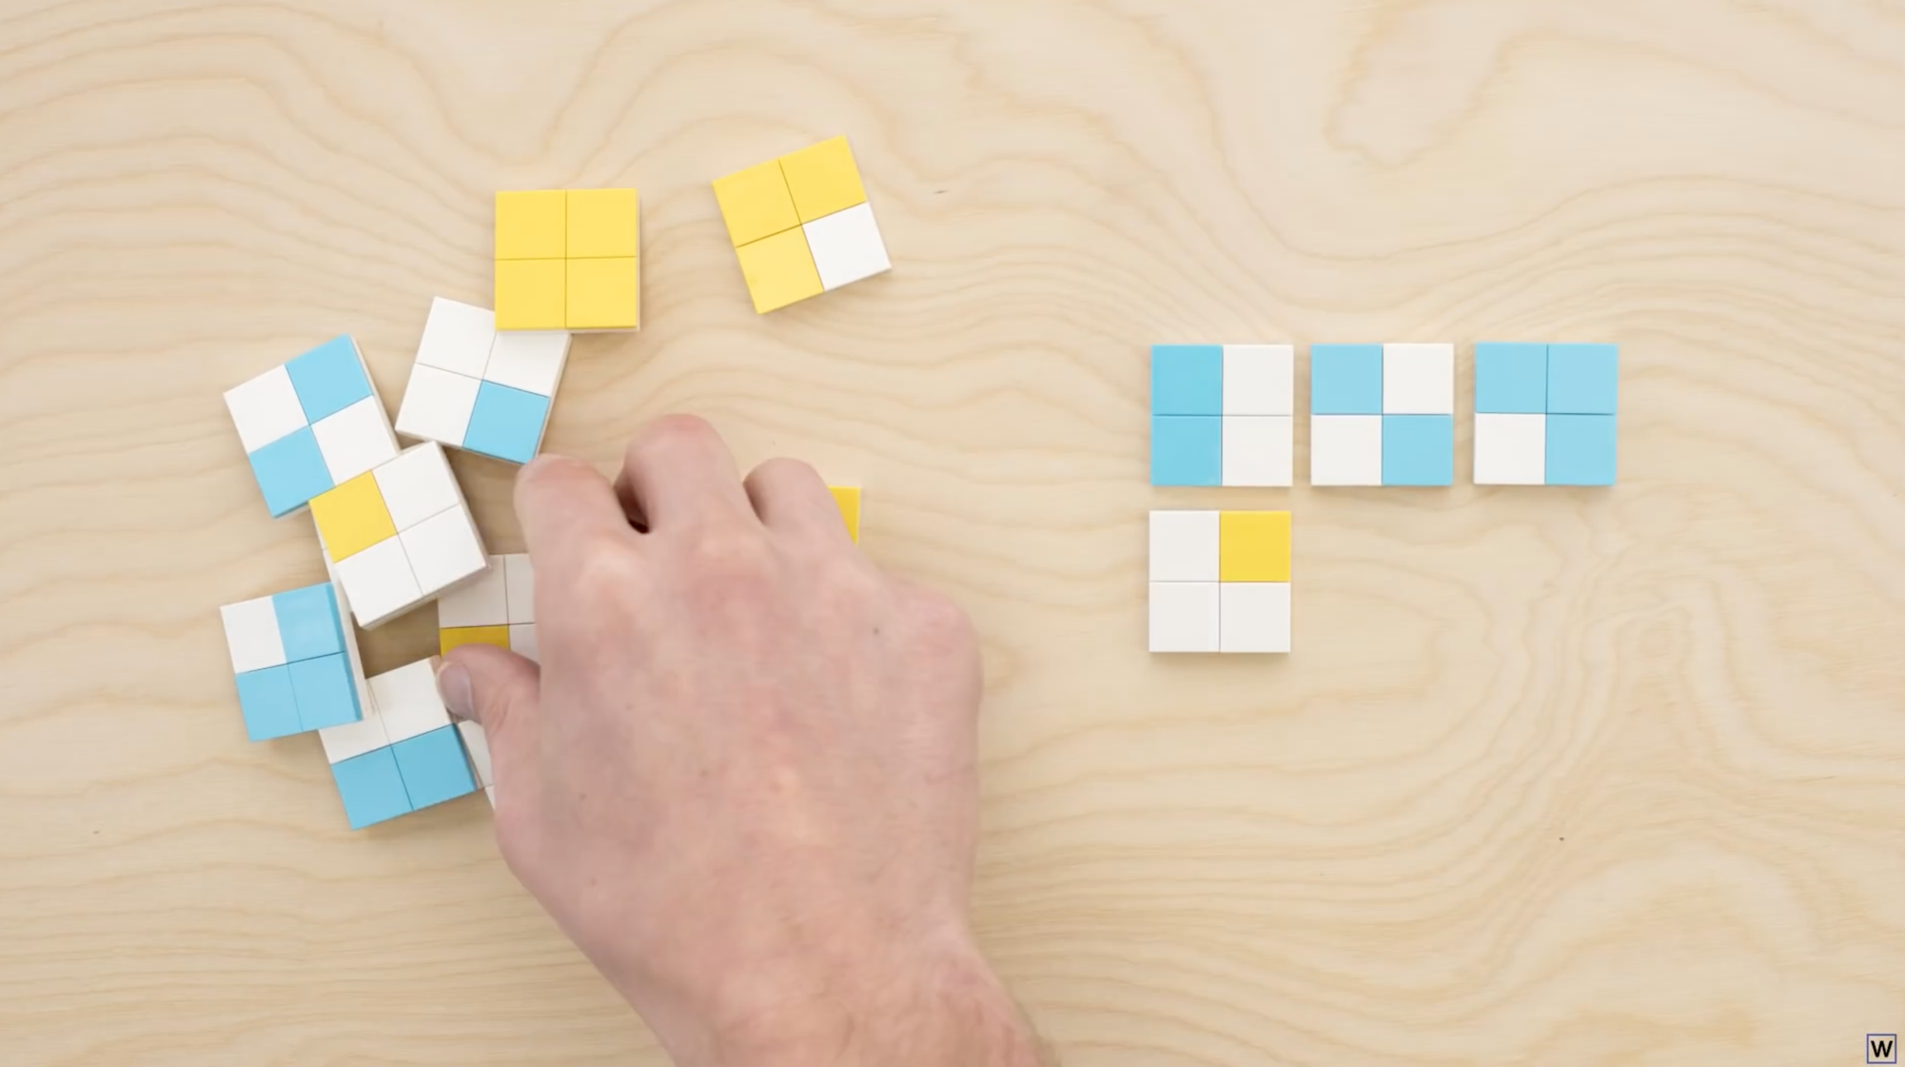
Let’s assume that our examples are randomly sampled.

Slide 23
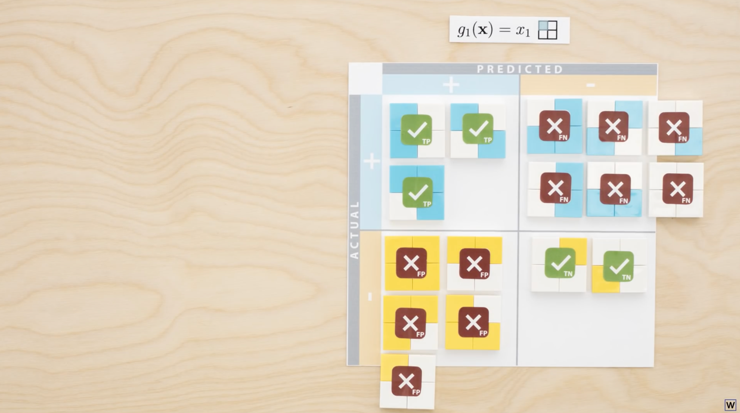
Further, let’s say that all 16 of our examples have these labels.

Slide 24
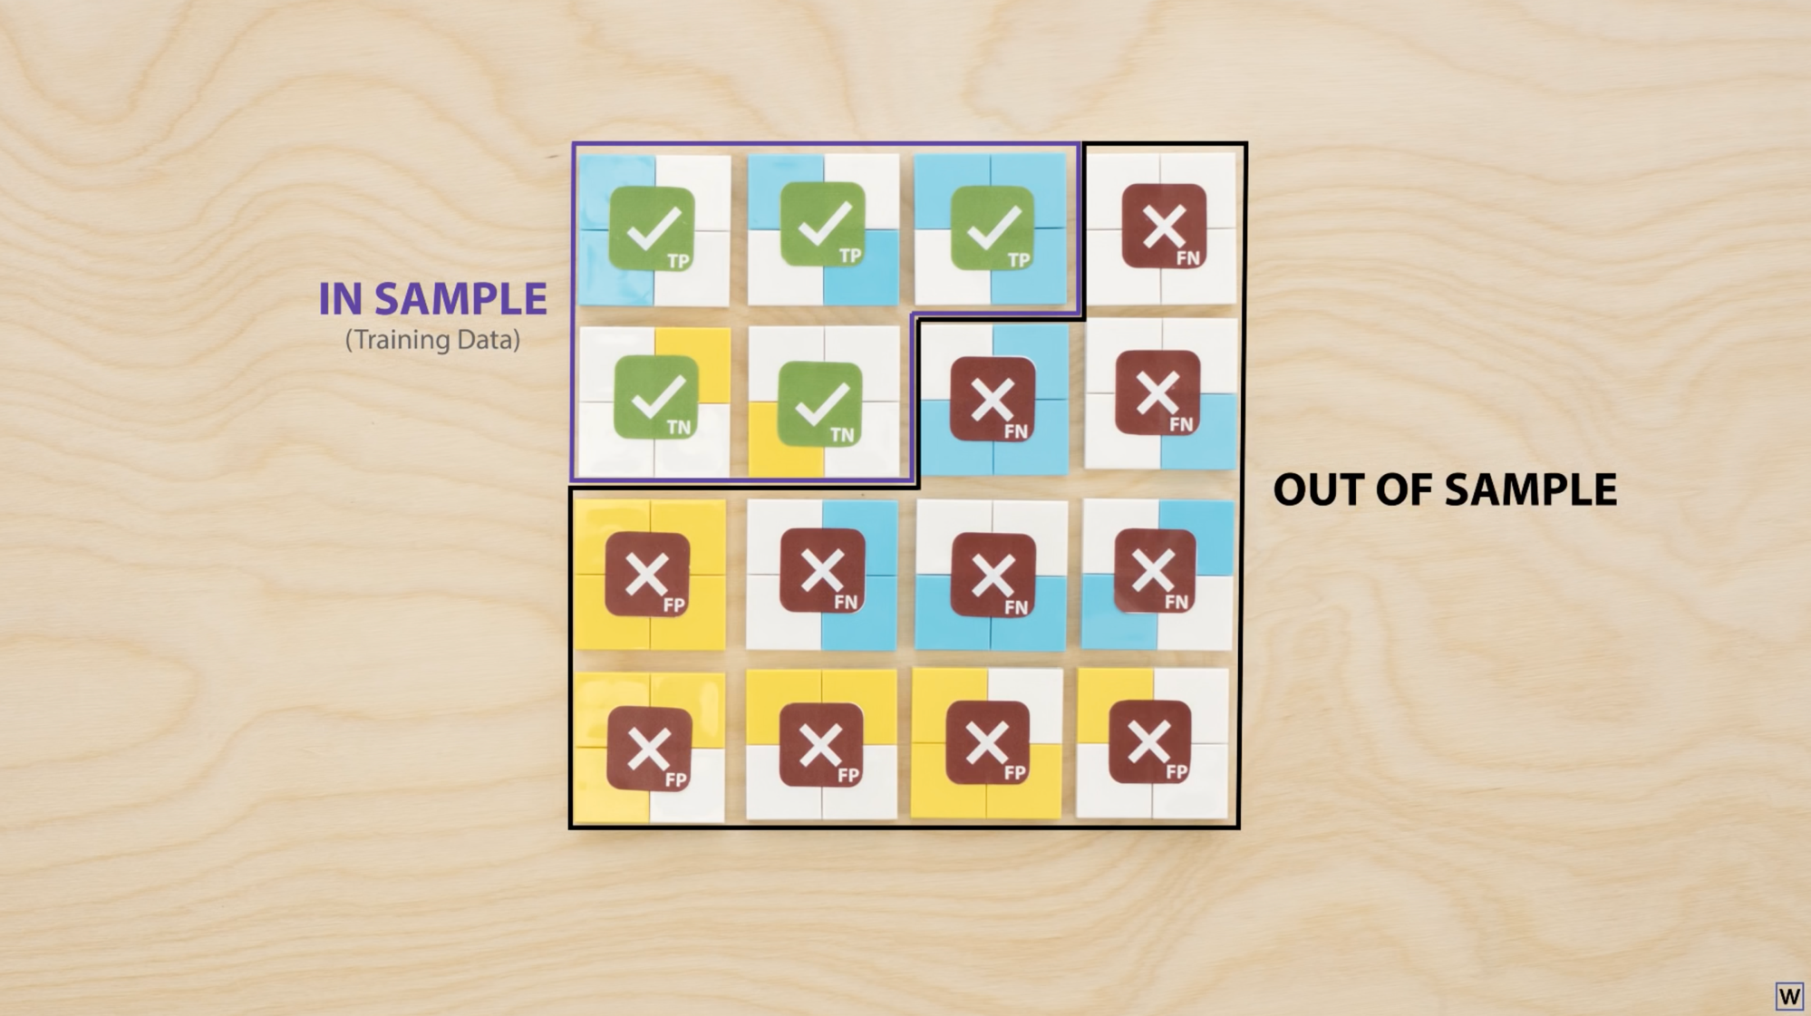
If our training set is sampled randomly, approximately what is the probability of this of selecting exactly the 5 examples where our rule is correct?
a) 5/16 b) 2/1000 c) 2/10,000 d) 5/10,000

Slide 25

So what is the probability of this (bad outcome) happening?
We’ll it depends…

Slide 26
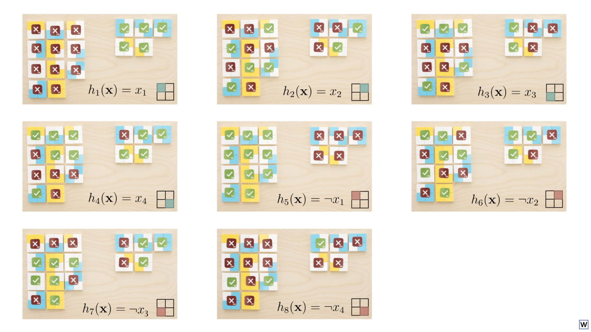
Remember that we first chose our rules from 8 possible rules!
Notes:
This means that really this is like taking 8 random samples, not 1. We could have gotten lucky for any of the 8 rules we considered.

Slide 27
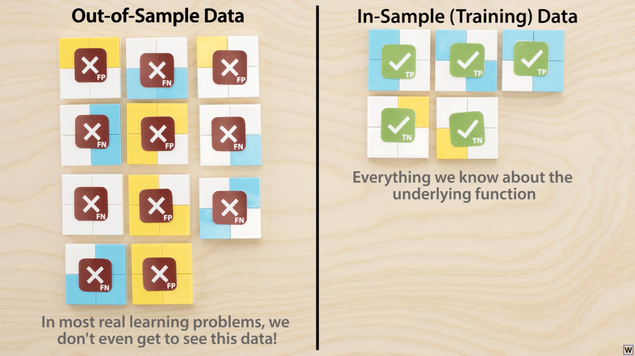
Notes:
Important point. Our training data is our only window into the function!

Slide 28
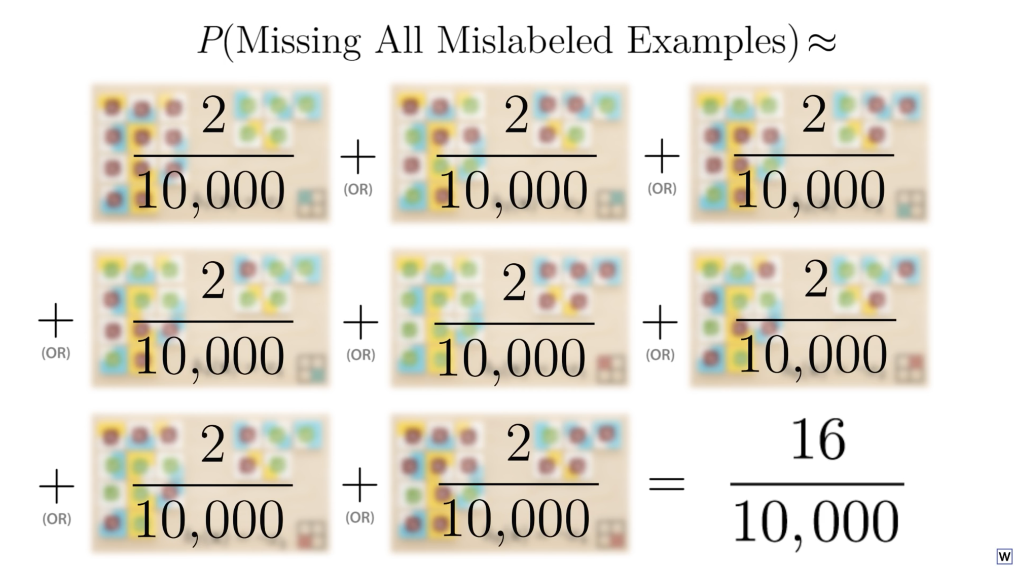
Notes:
So our probability is actually higher than we thought, but thankfully still pretty small. Meaning that this “getting lucky and failing to generalize thing” is pretty unlikely.

Slide 29
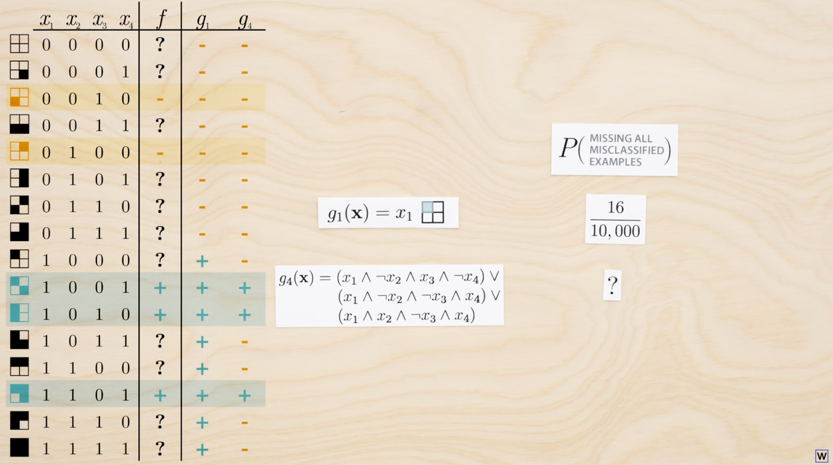
Does this change at all for a rule like g₄?
How many rules like g₄ exist?
(assuming that this class of rules can fit any truth table combination)
a) 16 b) 2048 c) 64,536 d) infinite

Slide 30
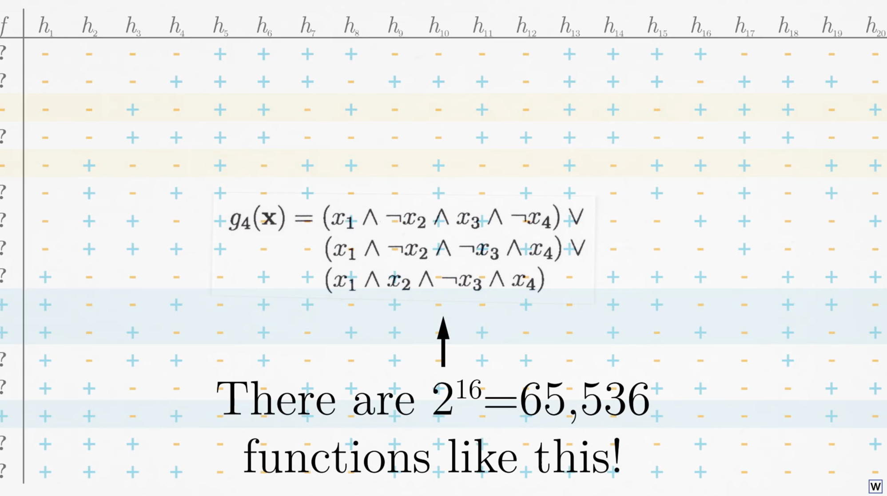

Slide 31
So what is the probability of this (bad outcome) happening?
…if we test 65,536 separate rules?

Slide 32
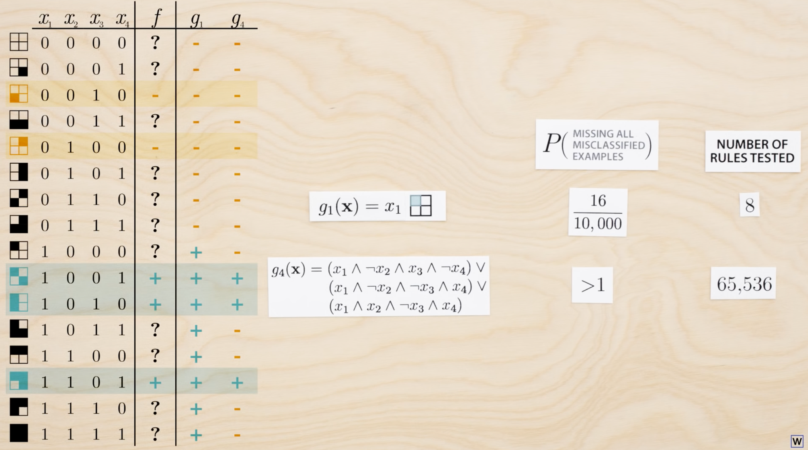
~

Slide 33
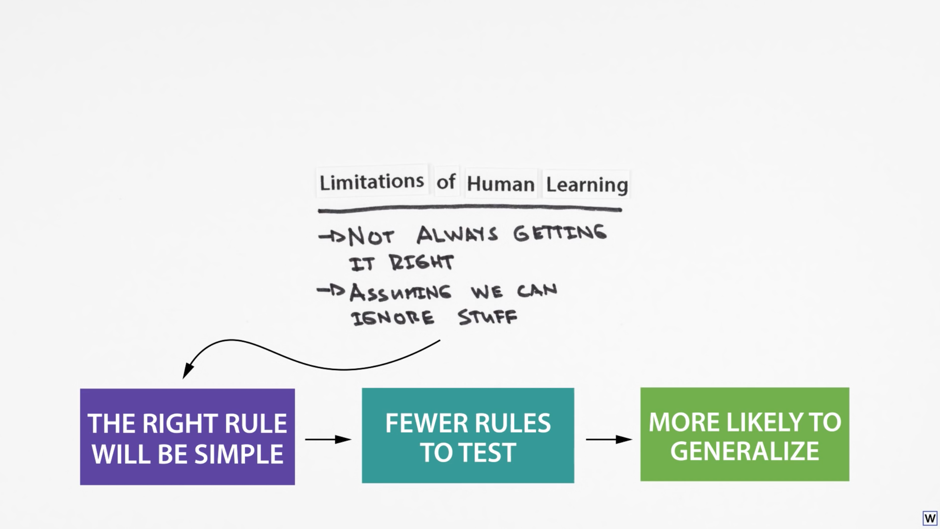
Notes:
So, perhaps hidden in the limitations of human learning are the keys to machine learning?

Slide 34
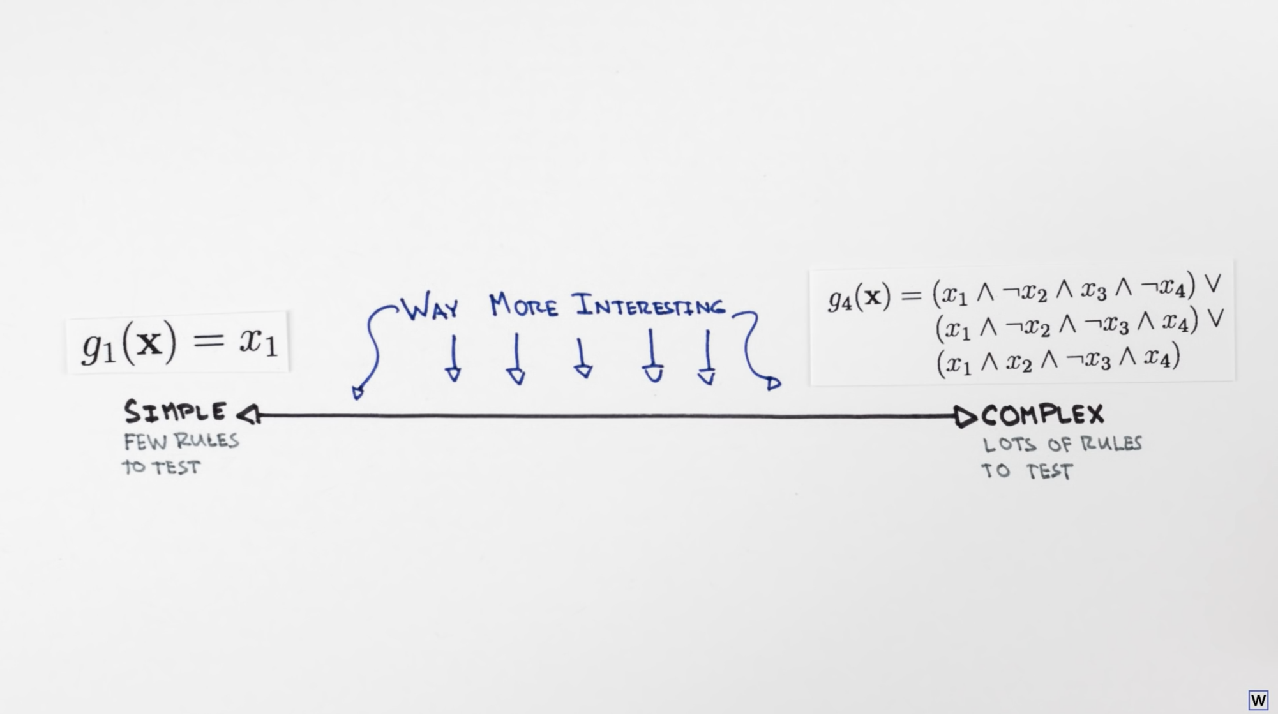

Slide 35
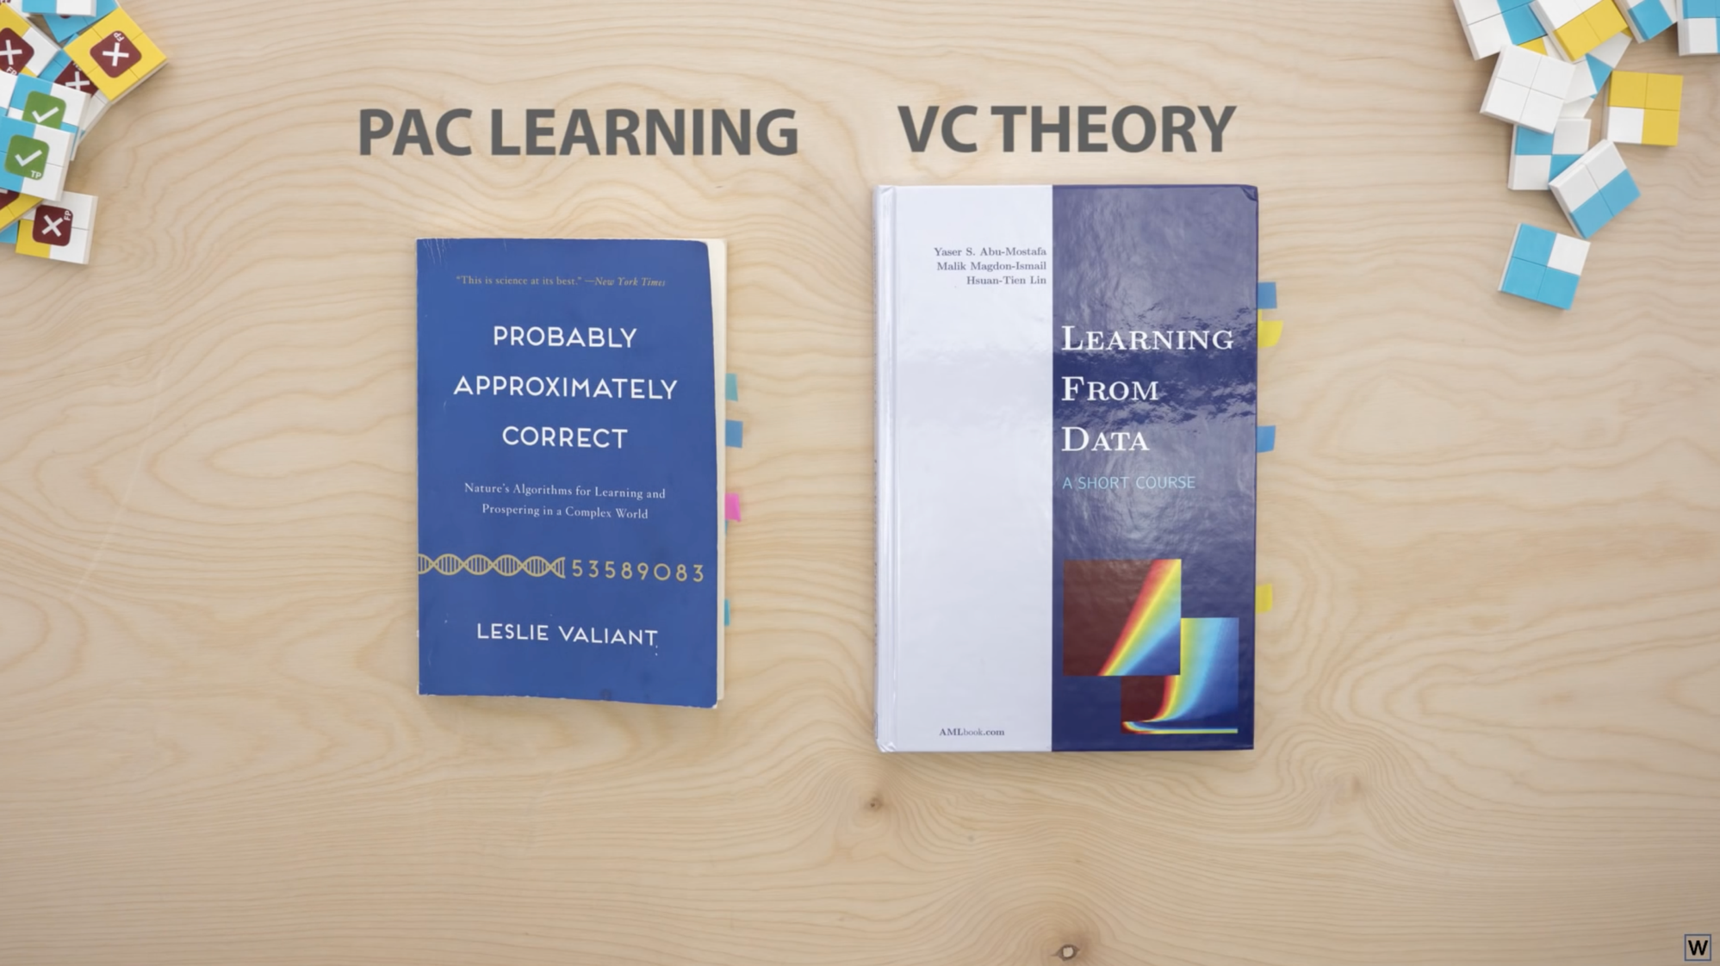
Notes:
More reading if you want to go deeper!

